Slide 1
Distance Vector Routing
Completely decentralized
No node has complete information about the costs of all network links
Gradual calculation of path by exchanging information with neighbors
Remember -- network as a graph ?

Slide 2
Specifics
Each node constructs a one-dimensional array containing the “distances” or “costs” to all other nodes (as it relates to its knowledge) and distributes it to its immediate neighbors.
Key thing -- each node knows the cost of links to its neighbors.
If no link exists between two nodes, the cost of a direct link between the nodes is “infinity”.

Slide 3
Routing Protocols: Distance vector (DV) Routing
Each router has unique ID
Each router knows cost of its outgoing links
Router starts with distance vector “0” for itself, and “infinity” for all other destinations
Transmits DV to each neighbor -- periodically or upon change
Saves the most recently received DV from each neighbor
Calculates new DV based on minimizing cost for each destination
Recalculations occur when:
DV with new values received from a neighbor
Link(s) fails

Slide 4
Operation of Distance Vector Routing (1)
From A | Link | Cost
A | local | 0
From B | Link | Cost
B | local | 0
Letters represent Node names
A
1
B
A=0
2
From C | Link | Cost
C | local | 0
C
3
4
Numbers on links/Distance represent link identifiers (not cost/next)
5
From D | Link | Cost
D | local | 0
D
6
E
From E | Link | Cost
E | local | 0

Slide 5
Operation of Distance Vector Routing (2)
From A | Link | Cost
A | local | 0
From B | Link | Cost
B | local | 0
A | 1 | 1 or A
E | 4 | 1 or E
C | 2 | 1 or C
D | inf | ----
B=0, A=1
A
B
1
2
C
From C | Link | Cost
C | local | 0
3
4
D=0, A=1
5
From D | Link | Cost
D | local | 0
A | 3 | 1 or A
D
6
E
From E | Link | Cost
E | local | 0

Slide 6
Operation of Distance Vector Routing (3)
From A | Link | Cost
A | local | 0
B | 1 | 1
D | 3 | 1
From B | Link | Cost
B | local | 0
A | 1 | 1
A=0, B=1, D=1
A
B
1
C=0, B=1, A=2
2
C
From C | Link | Cost
C | local | 0
B | 2 | 1
A | 2 | 2
3
4
5
From D | Link | Cost
D | local | 0
A | 3 | 1
D
6
E
From E | Link | Cost
E | local | 0
B | 4 | 1
A | 4 | 2
D | 6 | 1
E=0, B=1, A=2, D=1

Slide 7
Operation of Distance Vector Routing (4)
From A | Link | Cost
A | local | 0
B | 1 | 1
D | 3 | 1
From B | Link | Cost
B | local | 0
A | 1 | 1
D | 1 | 2
C | 2 | 1
E | 4 | 1
B=0, A=1, D=2, C=1, E=1
A
B
1
2
C
From C | Link | Cost
C | local | 0
B | 2 | 1
A | 2 | 2
D=0, A=1, B=2 E=1
3
4
5
From D | Link | Cost
D | local | 0
A | 3 | 1
B | 3 | 2
E | 6 | 1
D
6
E
From E | Link | Cost
E | local | 0
B | 4 | 1
A | 4 | 2
D | 6 | 1
C | 5 | 1
E=0, B=1, A=2, D=1, C=1

Slide 8
Operation of Distance Vector Routing (5)
From A | Link | Cost
A | local | 0
B | 1 | 1
D | 3 | 1
C | 1 | 2
E | 1 | 2
From B | Link | Cost
B | local | 0
A | 1 | 1
D | 1 | 2
C | 2 | 1
E | 4 | 1
A
B
1
These do not alter routing tables further Thus, no new updates generated
2
From C | Link | Cost
C | local | 0
B | 2 | 1
A | 2 | 2
E | 5 | 1
D | 5 | 2
C
3
4
5
From D | Link | Cost
D | local | 0
A | 3 | 1
B | 3 | 2
E | 6 | 1
C | 6 | 2
D
6
E
From E | Link | Cost
E | local | 0
B | 4 | 1
A | 4 | 2
D | 6 | 1
C | 5 | 1
DV routing has now converged

Slide 9
Drawbacks of Distance-vector Routing
Slow convergence after topology change
“Counting to infinity” problem:
Loop exists ,
DVs do not converge till the link costs reach “infinity ”
●
●
Problematic convergence with unequal link costs
Bouncing effect:
Routing and link costs temporarily stabilize, but have a loop
Data packets circulate in the loop till time-to-live (TTL) expires
This changes only when network converges to a new, coherent version of the routing tables

Slide 10
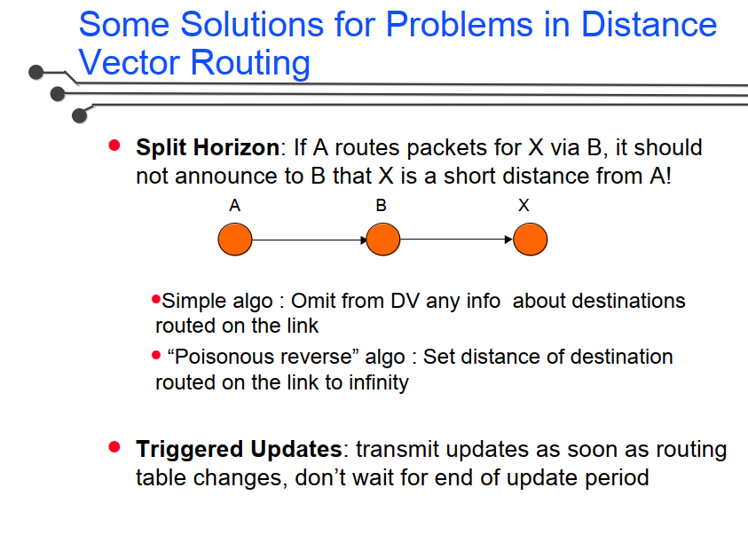

Slide 11
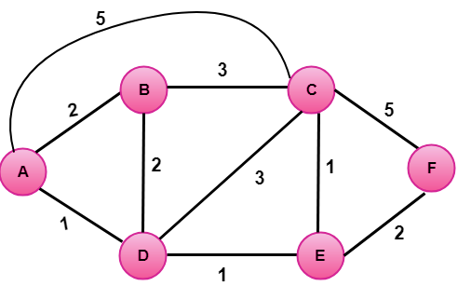
Class Activity
Calculate the Routing table for all routers

Slide 12
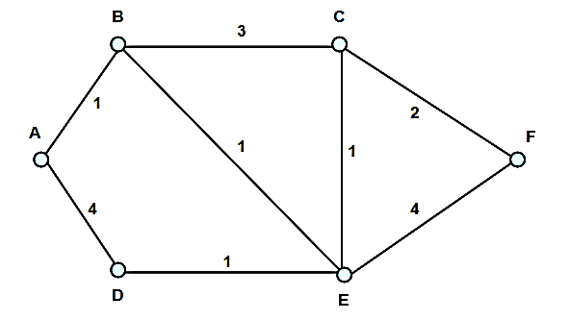
Class Activity
Consider the network shown below, where the numbers on the edges indicate the cost of using that edge. For example, the cost of using the link from Router A to Router B is 1, whereas the cost of using the link from Router A to Router D is 4. Calculate the Routing table for all routers

